Slide 1

AI-Powered Emergency Triage Optimisation
Group 3 – MSc Business Analytics – University College Cork
Module: IS6611 – Applied Research in Business Analytics
Presentation Date: 9 July 2025
Dileep Kumar Varma, Penmetsa -124116108
Aryan Bhavesh Gadkar -124115675
Cindy Justine Allen -124112017
Dinesh Naga Siva Ram Pabolu -124106368
Sai Nikhil Vaddadi -124107966
Harshank Prasad Belagur Narendra Prasad -124115817
Mentor: Jimmy Hennessy
Notes:
1

Slide 2


Problem Statement & Sustainable Goals
Overcrowded emergency departments cause delayed critical care
Aligned SDGs:
Manual prioritisation lacks accuracy and consistency
SDG 3
Good Health & Wellbeing (Target 3.8)
Our solution automates triage severity prediction to improve patient outcomes
SDG 9
Industry, Innovation & Infrastructure
Sai Nikhil (124107966)
Notes:
3

Slide 3
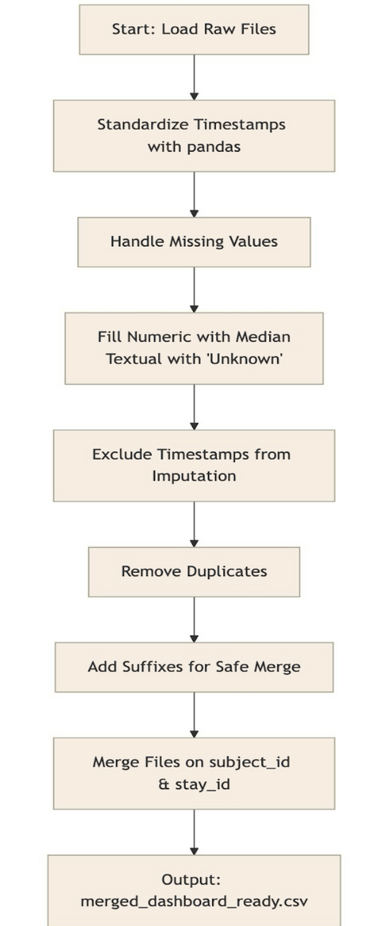
Datasets Used for Triage Analytics
Dataset Name
Description
Records
Key Columns
edstays
ED admission & stay info
222
subject_id, stay_id, intime, outtime
vitalsign
Vitals measured
1,038
charttime, heartrate, sbp, dbp, temp
medrecon
Medication records
2,764
charttime, med_name
triage3
Triage complaints
222
chiefcomplaint, acuity
pyxis3
Medication dispensing
1,082
charttime, med_name
diagnosis3
Diagnosis codes
545
icd_code, long_title
Data sourced from MIMIC-IV demo datasets; cleaned, merged, and balanced for model training. Final merged dataset contained 285,418 rows due to many-to-many joins across vitals, medications, triage, and diagnosis data.
Link of datset: https://physionet.org/content/mimic-iv-ed-demo/2.2/
Sai Nikhil (124107966)
Figure: End-to-end data cleaning & merge workflow
Notes:
13

Slide 4




Business Value
For Doctors
For Admins
Immediate visibility on critical patients
Efficient queue management reduces chaos
For Patients
Faster care, reduced anxiety, improved trust
Supports data-driven decision-making and efficient resource allocation
Sai Nikhil (124107966)
Notes:
2

Slide 5
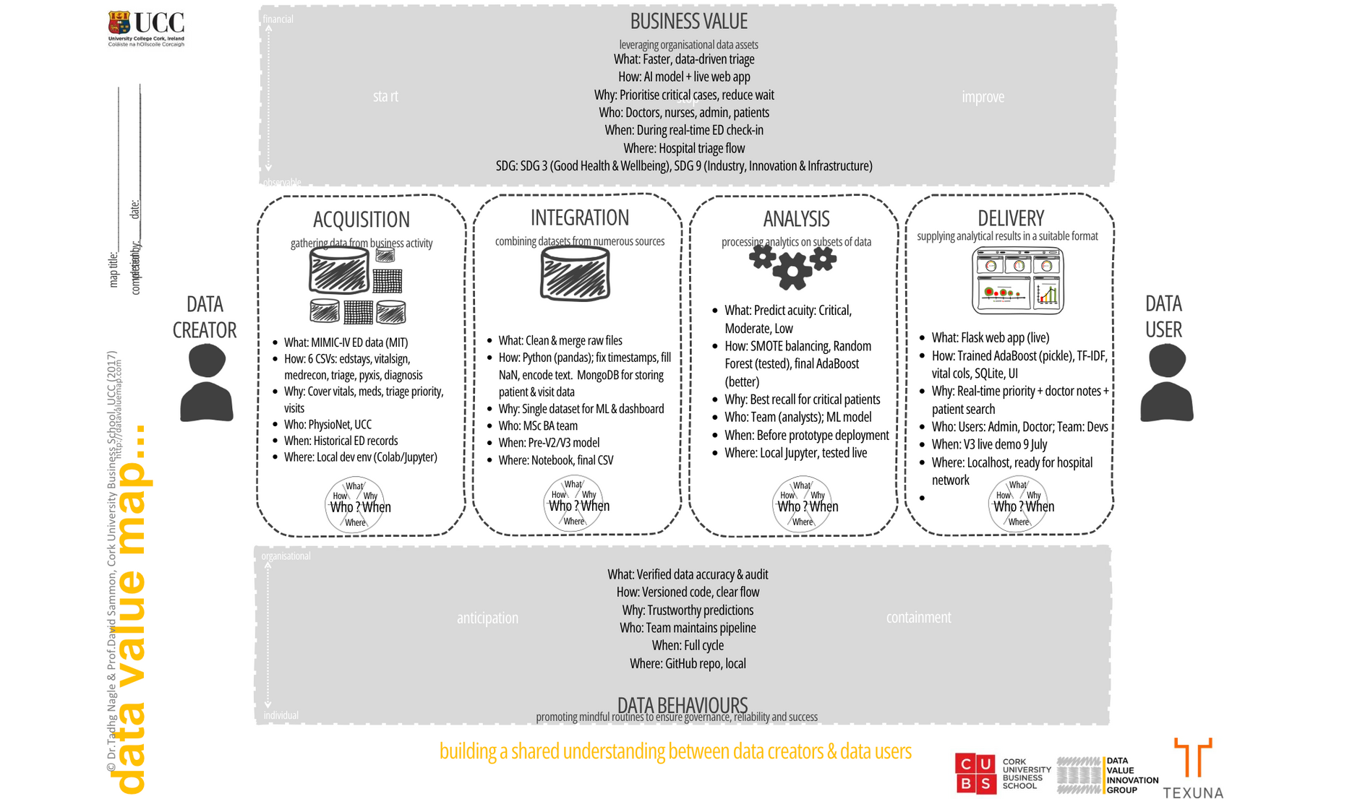
Data Value Map – Project Lifecycle
Sai Nikhil (124107966)
Notes:
4

Slide 6
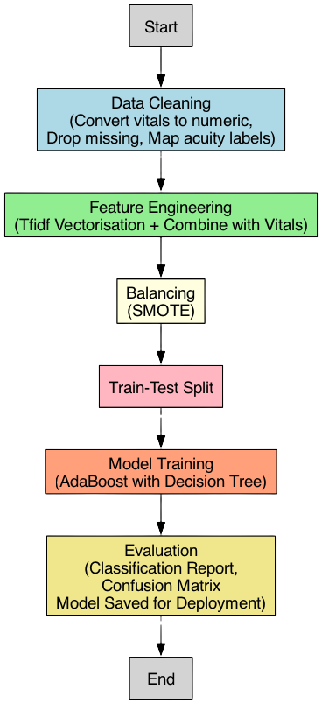
Data Preparation & Modelling Pipeline Overview
Data Cleaning
Handled missing vitals with median imputation
Feature Engineering
Label encoded categorical features
Balancing
Balanced class distribution using SMOTE
Model Selection
Tested Random Forest (62% accuracy) ➔ switched to AdaBoost (74% accuracy)
Deployment
Exported model with pickle for Flask integration
Backend database: MongoDB for storing patient records and visit logs
Sai Nikhil (124107966)
Figure: Pipeline diagram auto-generated from final AdaBoost implementation.
Notes:
5

Slide 7
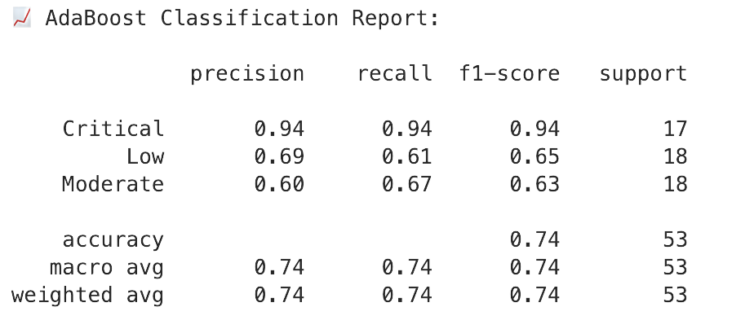
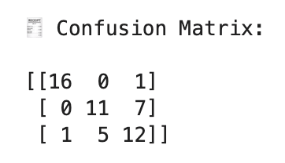
Model Evaluation & Choice
Random Forest:
Fast, but low recall for critical class
Random Forest achieved 62% accuracy with poor recall for critical class due to imbalanced data.
AdaBoost:
Better precision-recall balance, especially for critical patients
Why AdaBoost works:
Combines weak learners to reduce bias and variance
Handles imbalanced data with boosting iterations
Model Evaluation Metrics (Test Set Results)
Sai Nikhil (124107966)
Notes:
6

Slide 8


AdaBoost Results
74%
94%
Accuracy
Critical Class Recall
Overall model performance
Detection rate for highest severity patients
Key takeaway: Prioritises critical patients effectively, ensuring clinical value
Sai Nikhil (124107966)
Notes:
7

Slide 9
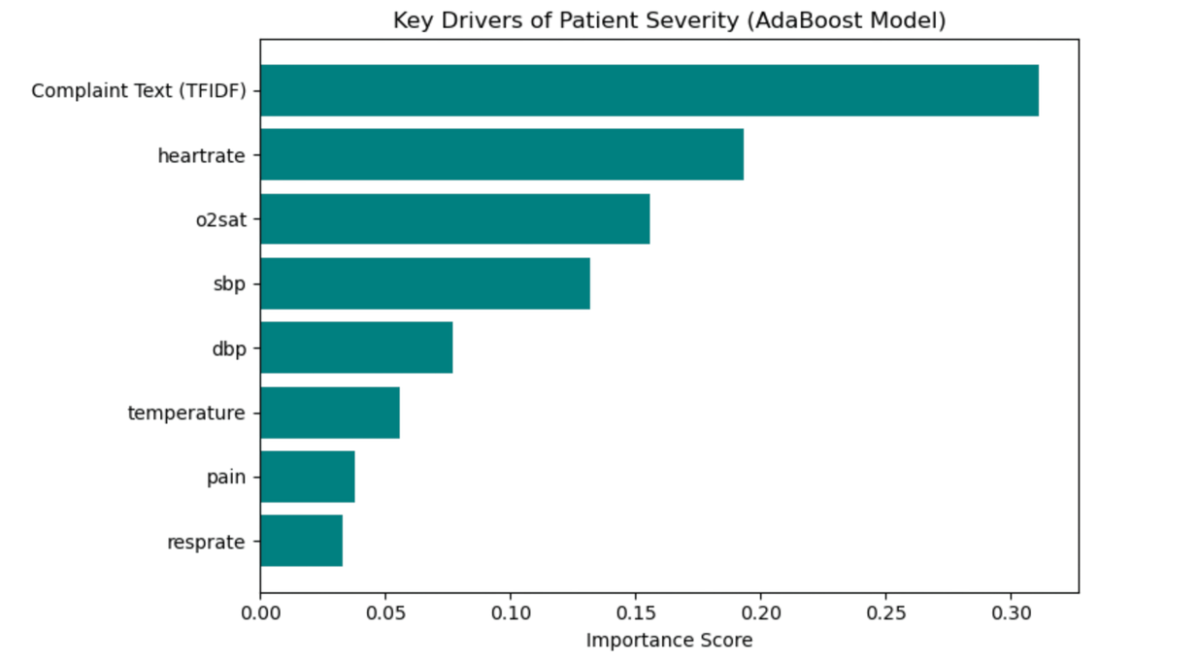
Key Drivers of Severity
Temperature, heart rate, and systolic blood pressure (SBP) emerged as the top predictors of patient severity, aligning well with clinical expectations.
Complaint text analysis added significant predictive value by capturing nuanced patient conditions that vital signs alone might miss.
Other features such as oxygen saturation, diastolic BP, respiratory rate, and pain score contributed moderate importance, supporting a holistic assessment.
This feature importance ranking validates that our model mirrors real-world triage decision logic used by experienced clinicians, enhancing its operational trustworthiness.
Cindy (124112017)
Notes:
8

Slide 10








Final Technology Architecture & Data Flow
Data Processing
User Interface
Python (pandas, scikit-learn, imblearn) for data processing and ML
Flask app for user interface and real-time predictions
Deployment
Visualization
Deployed locally for demonstration; future plan includes integration with hospital IT systems for scaling.
Tableau dashboard for queue visualisation
Data Processing ➔ User Interface ➔ Visualisation ➔ Deployment
Dinesh (124106368)
Notes:
9

Slide 11
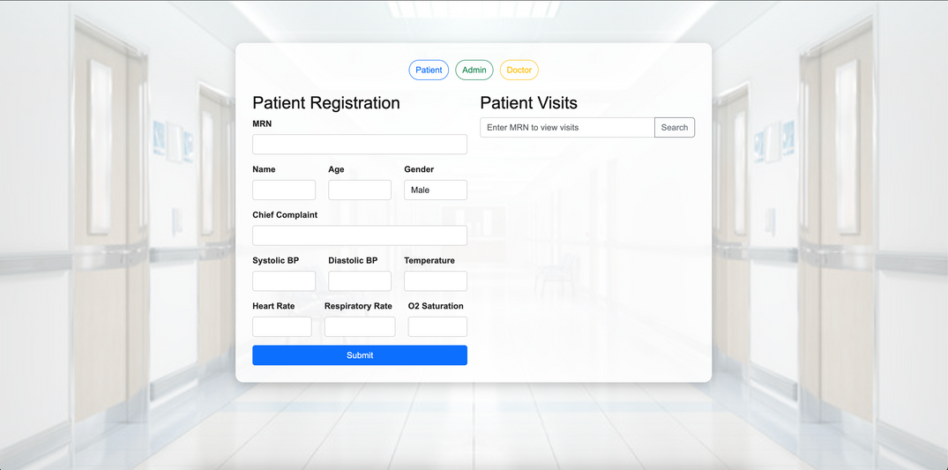
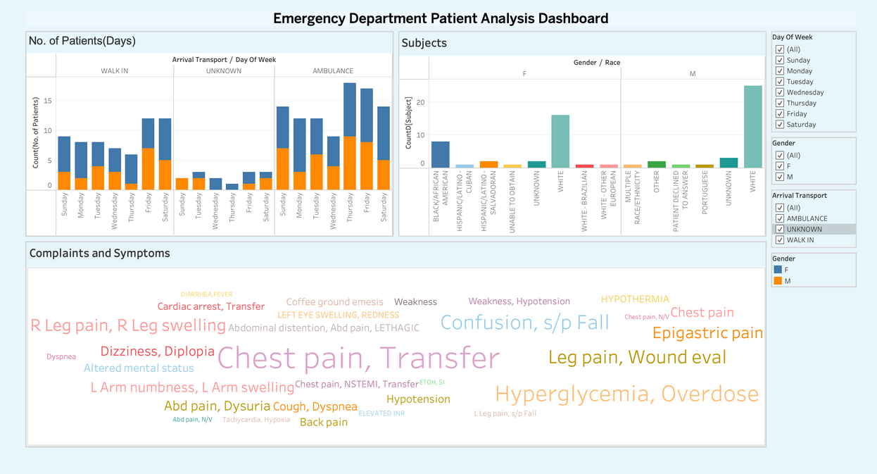
Live Demonstration
We will demonstrate:
Flask app with:
Patient intake form
Admin dashboard for queue management
Doctor dashboard showing prioritised patients
Flask Application Preview
Tableau dashboard displaying:
Real-time queue statistics
Insights on patient flow
Tableau Dashboard Snapshot
Demonstrating integrated AI prediction with real-time operational insights.
Dileep (124116108)
Aryan (124115675)
Notes:
10

Slide 12

What's Next After V3?
1
Model Optimisation
Enhance model performance using hyperparameter tuning and additional features.
2
Role Expansion
Tailored dashboards for nurses and paramedics.
3
Accessibility
Enhance accessibility for remote and under-resourced regions.
4
Open Source
Open-source release to support adoption by public healthcare systems worldwide.
Harshank (124115817)
Notes:
11

Slide 13

Thank You
"Empowering Emergency Care with Data & Analytics"
Group 3 – We welcome your questions
Presented by Harshank (124115817) on behalf of the team
Notes:
12

